Slide 1

TRUSTED DIGITAL WEB The Future of the Internet and the World Wide Web
Trusted
Digital
Web
Michael Herman Hyperonomy Digital Identity Lab Parallelspace Corporation Alberta, CANADA

Slide 2
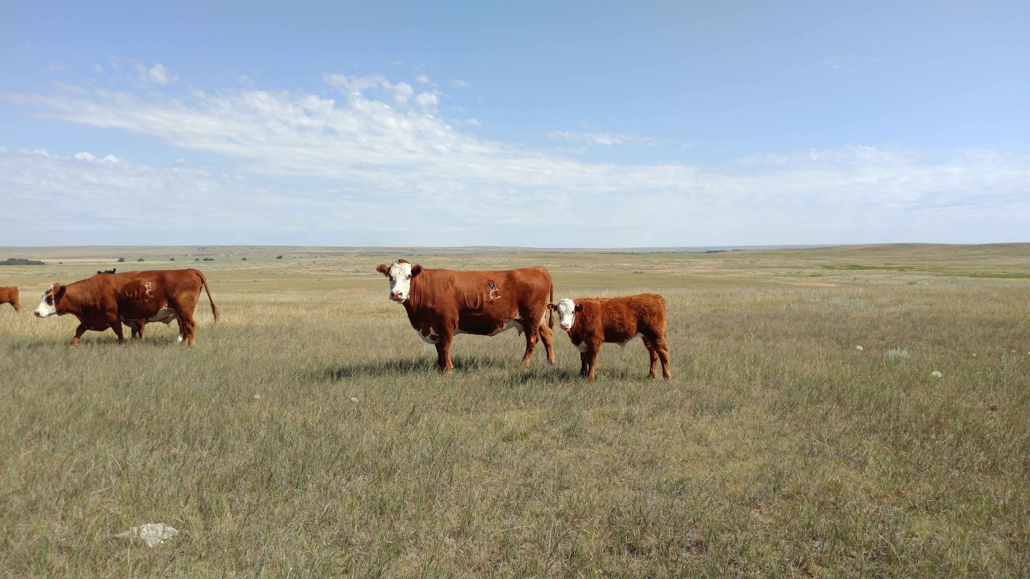
Michael Herman Self-Sovereign Blockchain Futurist, Architect, and Developer Hyperonomy Digital Identity Lab Parallelspace Corporation Alberta, CANADA
RFID
R
C
Left Rib
Ranchville Cattle Company
SW 34-20-2W4
Box 45, Bindloss, Alberta

Slide 3
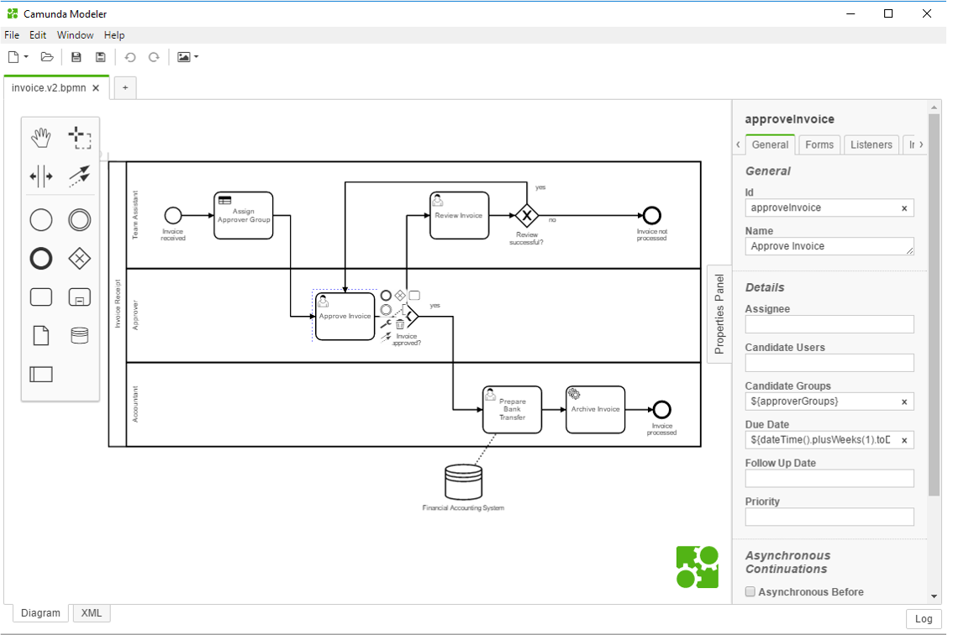
Workflows and Business Processes
Enterprise Architect
Member of the Microsoft SharePoint product group
Salesforce.com Solution Developer

Slide 4
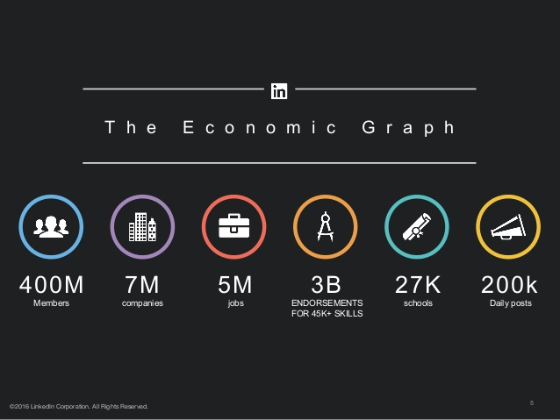
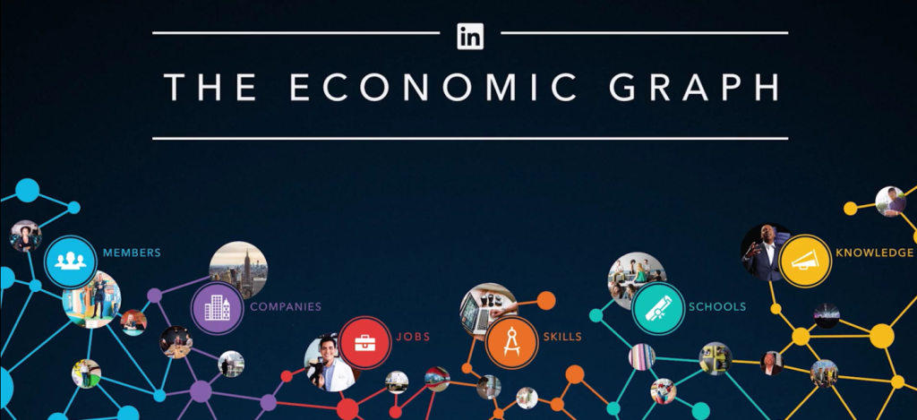
LinkedIn: The Economic Graph

Slide 5
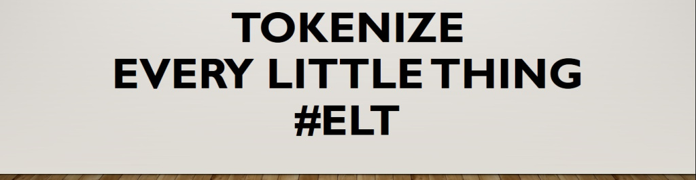
Tokenize Every Little Thing (#ELT)
Blockchain Architect and Developer
Ethereum
NEO (C# / .NET Core), SerentityData Entity Serialization for the Blockchain
Hyperledger Indy (Identity)
Stratis Platform (C# / .NET Core)

Slide 6
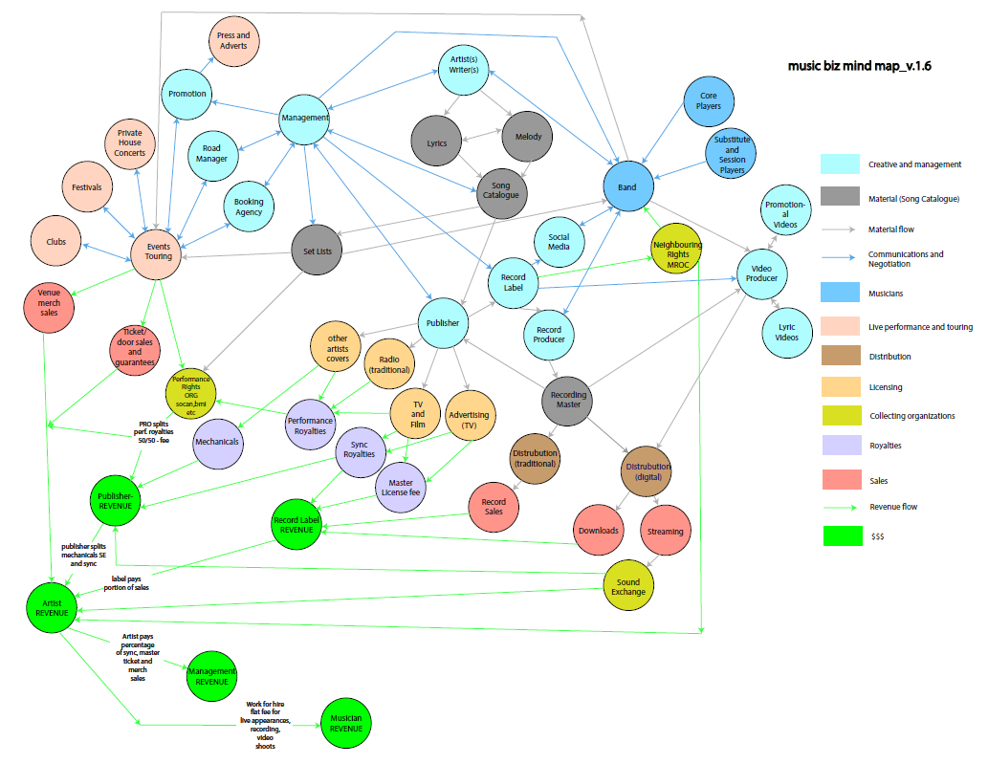
Digital Identity Networks (DID Networks)

Slide 7
Agenda
Problems and Motivations
A Solution Concept
Final Notes

Slide 8
Problems and Motivations

Slide 9
The Trust Problem
The Internet global communications network and the World Wide Web (WWW) software application is the fabric that knits together and enables individuals, governments, corporations, and other organizations to share, consume, and interact with a universal sea of data and information representing every aspect of our lives and livelihoods.
But today we live in a world of fundamental distrust.
Pervasive distrust in our governments, other countries’ governments, our politicians, other governing institutions, our financial institutions, large corporations (global food conglomerates, major manufacturers), the daily, hourly and instantaneous streams of information we consume (news, weather, climate, and other world-impacting events), and the social platform companies and software applications we interact with every day.
Notes:
What is the solution? What’s “next”? …perhaps it’s something called the Trusted Digital Web (TDW).

Slide 10
What is trust?
Definitions of trust typically refer to a situation characterized by the following aspects:
one party (trustor) is willing to rely on the actions of another party (trustee); the situation is directed to the future.
In addition, the trustor (voluntarily or forcedly) abandons control over the actions performed by the trustee. As a consequence, the trustor is uncertain about the outcome of the other's actions; they can only develop and evaluate expectations.
The uncertainty involves the risk of failure or harm to the trustor if the trustee will not behave as desired.
Wikipedia: https://en.wikipedia.org/wiki/Trust_(social_science)

Slide 11
What is Distrust?
Noun
the feeling that someone or something cannot be relied upon.
synonyms: mistrust, suspicion, wariness, chariness, lack of trust, lack of confidence, lack of faith; skepticism, doubt, doubtfulness, dubiety, cynicism; misgivings, questioning, qualms; disbelief, unbelief, incredulity, incredulousness, discredit; informalleeriness
Verb
doubt the honesty or reliability of; regard with suspicion.
synonyms: mistrust, be suspicious of, be wary/chary of, regard with suspicion, suspect, look askance at, have no confidence/faith in; be skeptical of, have doubts about, doubt, be unsure of/about, be unconvinced about, take with a pinch/grain of salt; have misgivings about, wonder about, question;
Lexico.com: https://www.lexico.com/en/definition/distrust

Slide 12
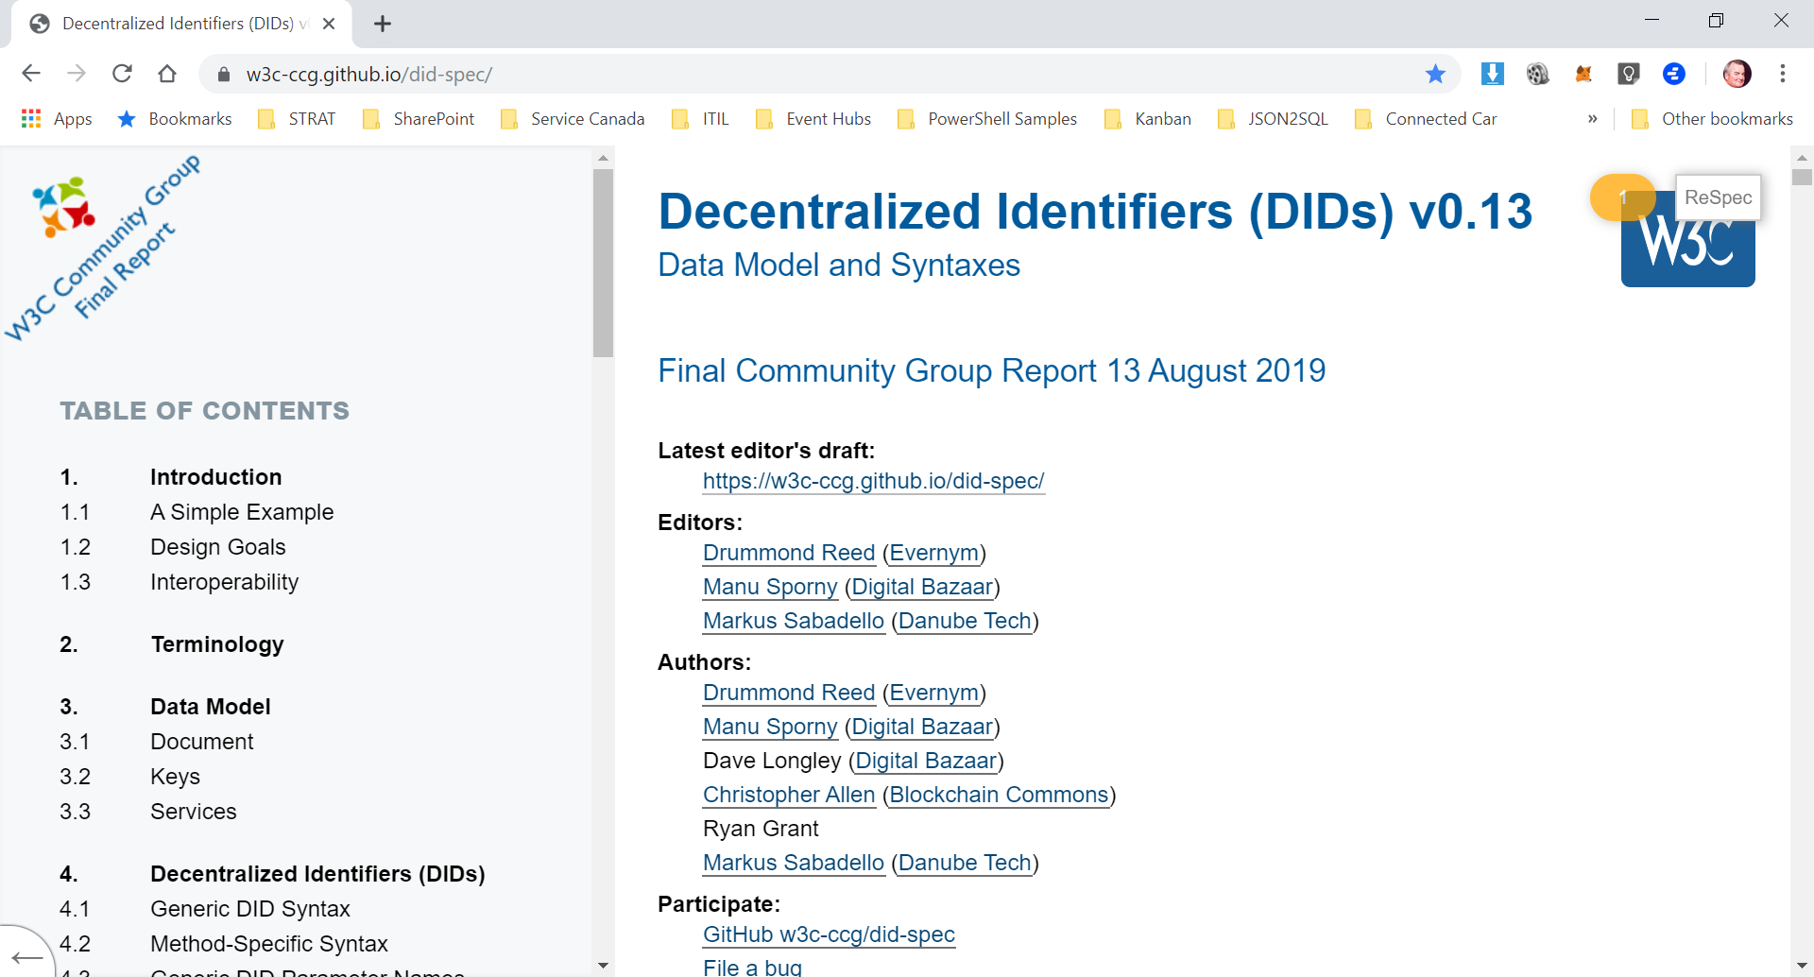
The “Thing” Problem
DID-SPEC: Focus limited to people and organizations and verifiable identities
“Things” were mentioned but otherwise missing from the specification; esp. Business Documents

Slide 13
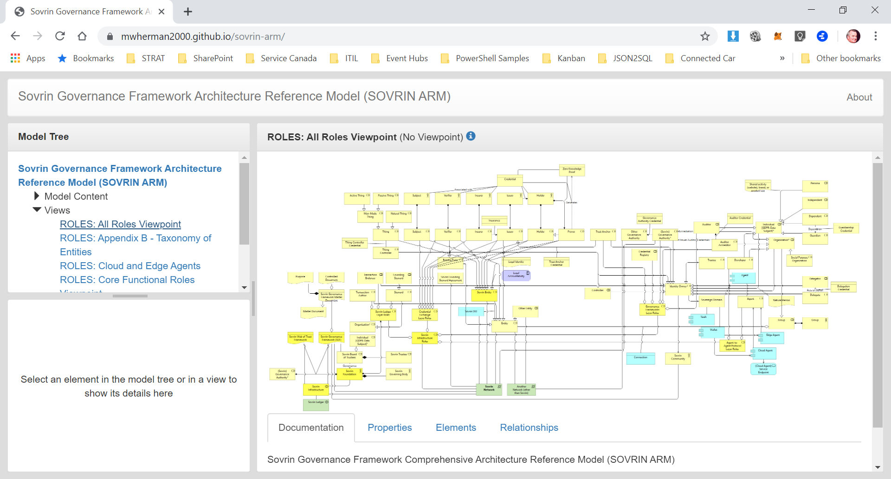
The “Thing” Problem
Sovrin Governance Framework and Glossary: Same initial focus was people and organizations
“Things” and “Thing Controllers” are now (almost) first-class citizens in the framework

Slide 14
Additional Context

Slide 15
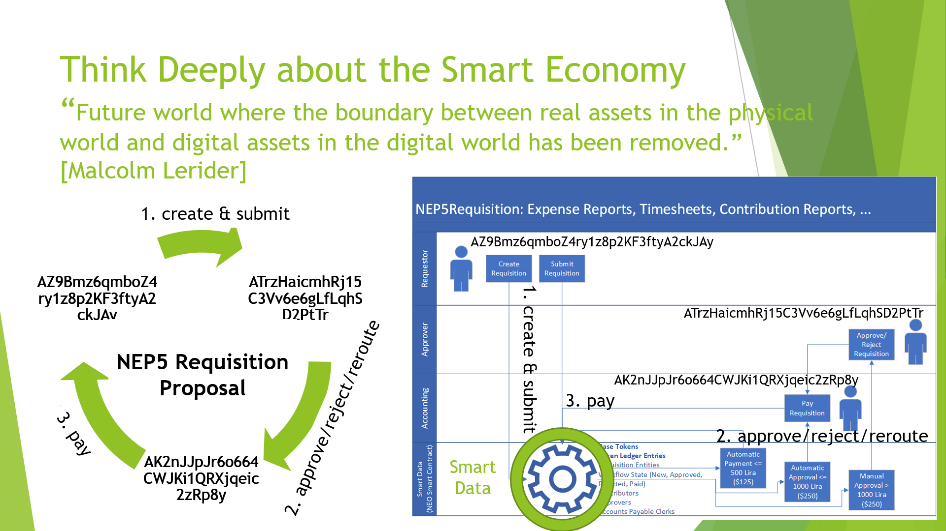

Slide 16
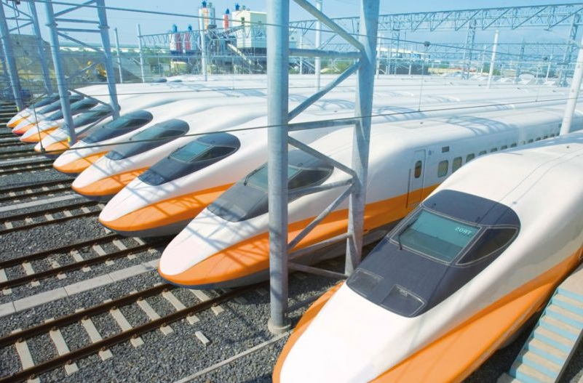
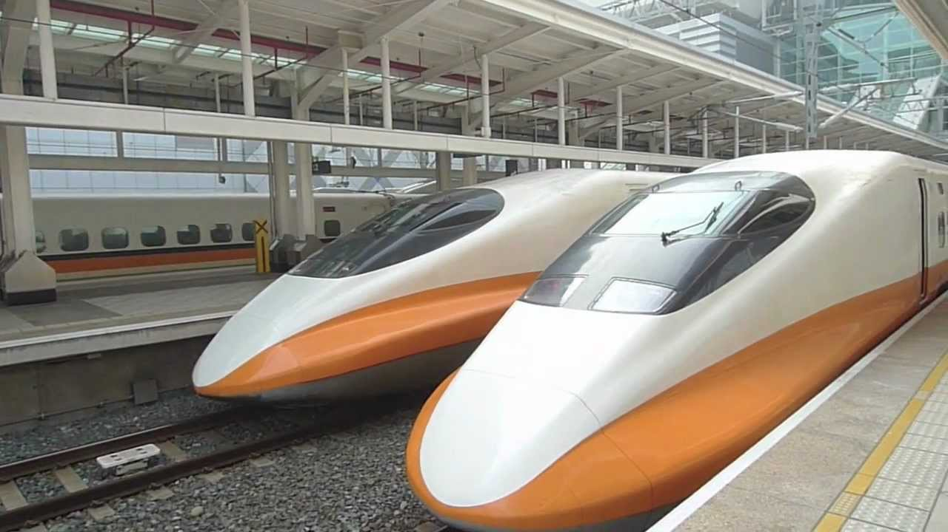
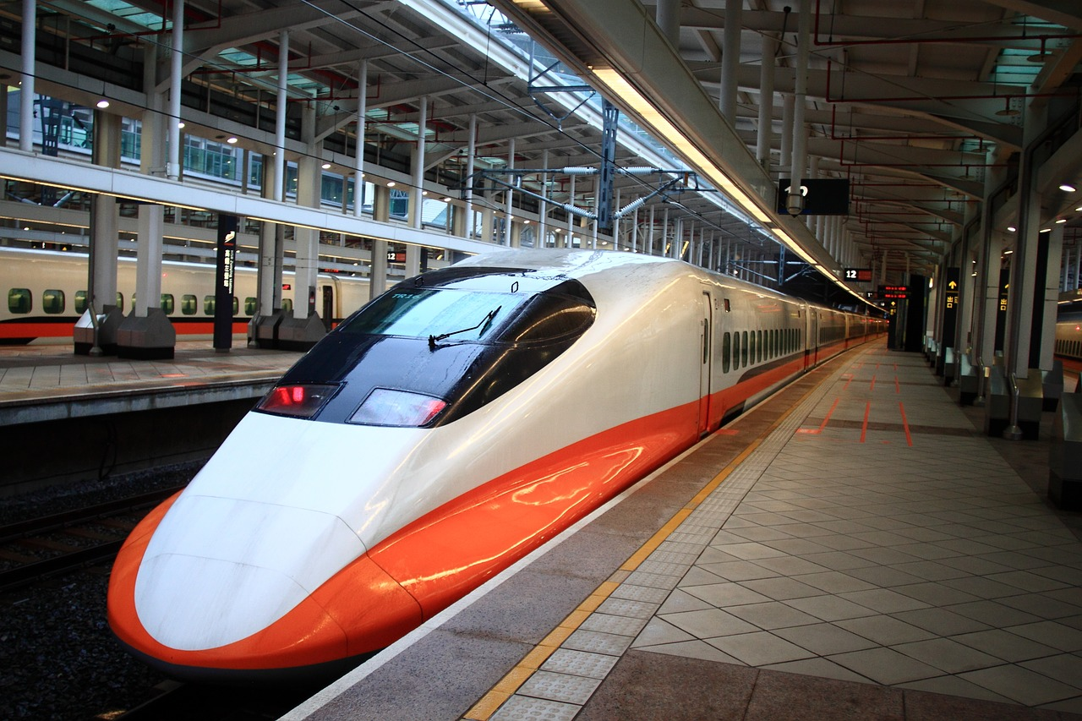
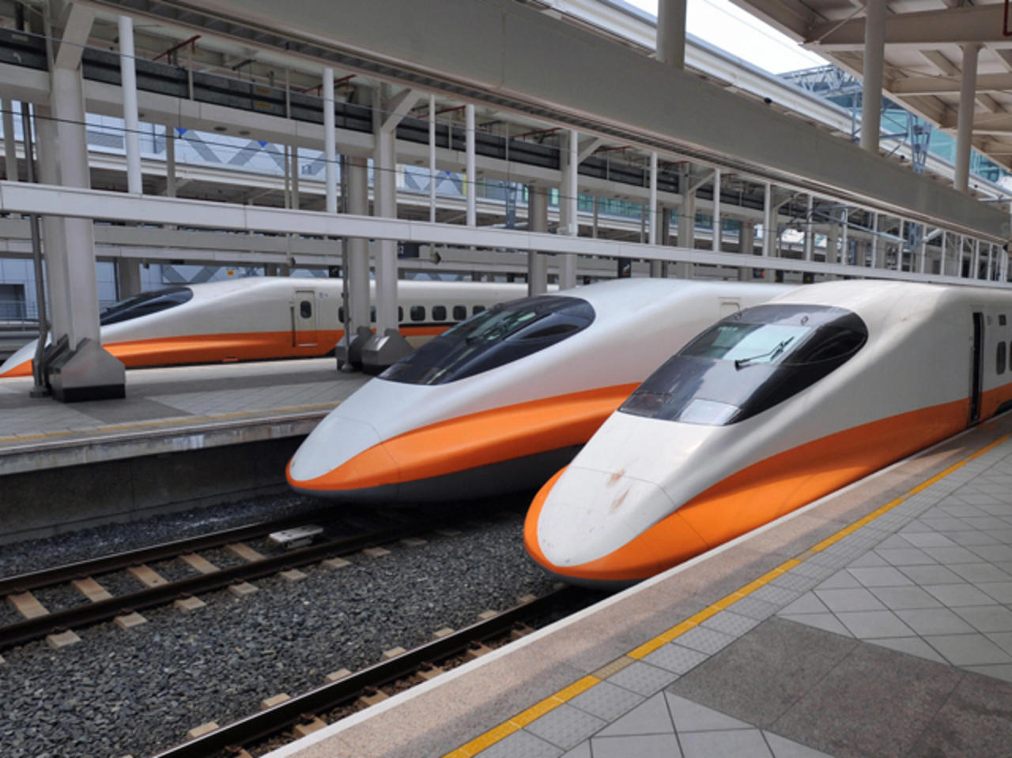
The Blockchain world Started to GROW & Multiply
Workflows &
Business Processes
Universality
Verifiable Trust
Digital Identity
Smart Contracts
Notes:
How many times have you heard smart contracts mentioned this week? …almost none at all.

Slide 17
Requirements for A NEW Solution
A new solution is needed that integrates and knits together:
Payments
Business Processes
Business Documents
A new model is needed to support:
Universal
Trusted
Frictionless
Integrated
Standards-based
General-purpose
End-to-end, Global Commerce, Communications, and Collaboration Platform

Slide 18
A Solution

Slide 19
A new Solution Based Fundamentally on Trust
Trust is one of the things that permeates across the whole business. It is the bedrock of business and without it organizations are going to struggle to keep their existing customers, gain new customers or enter new markets.
[Stephen Walsh, director of security for Northern Europe, CA: https://www.csoonline.com/article/3297037/what-is-digital-trust-how-csos-can-help-drive-business.html]

Slide 20

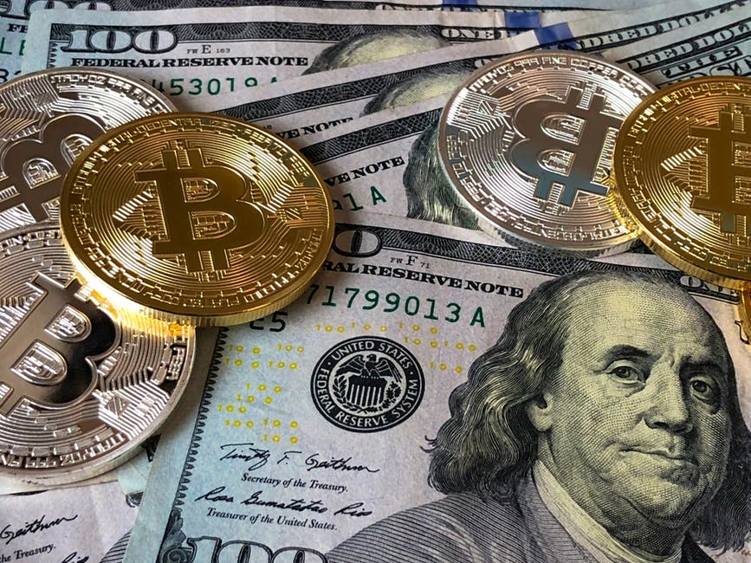
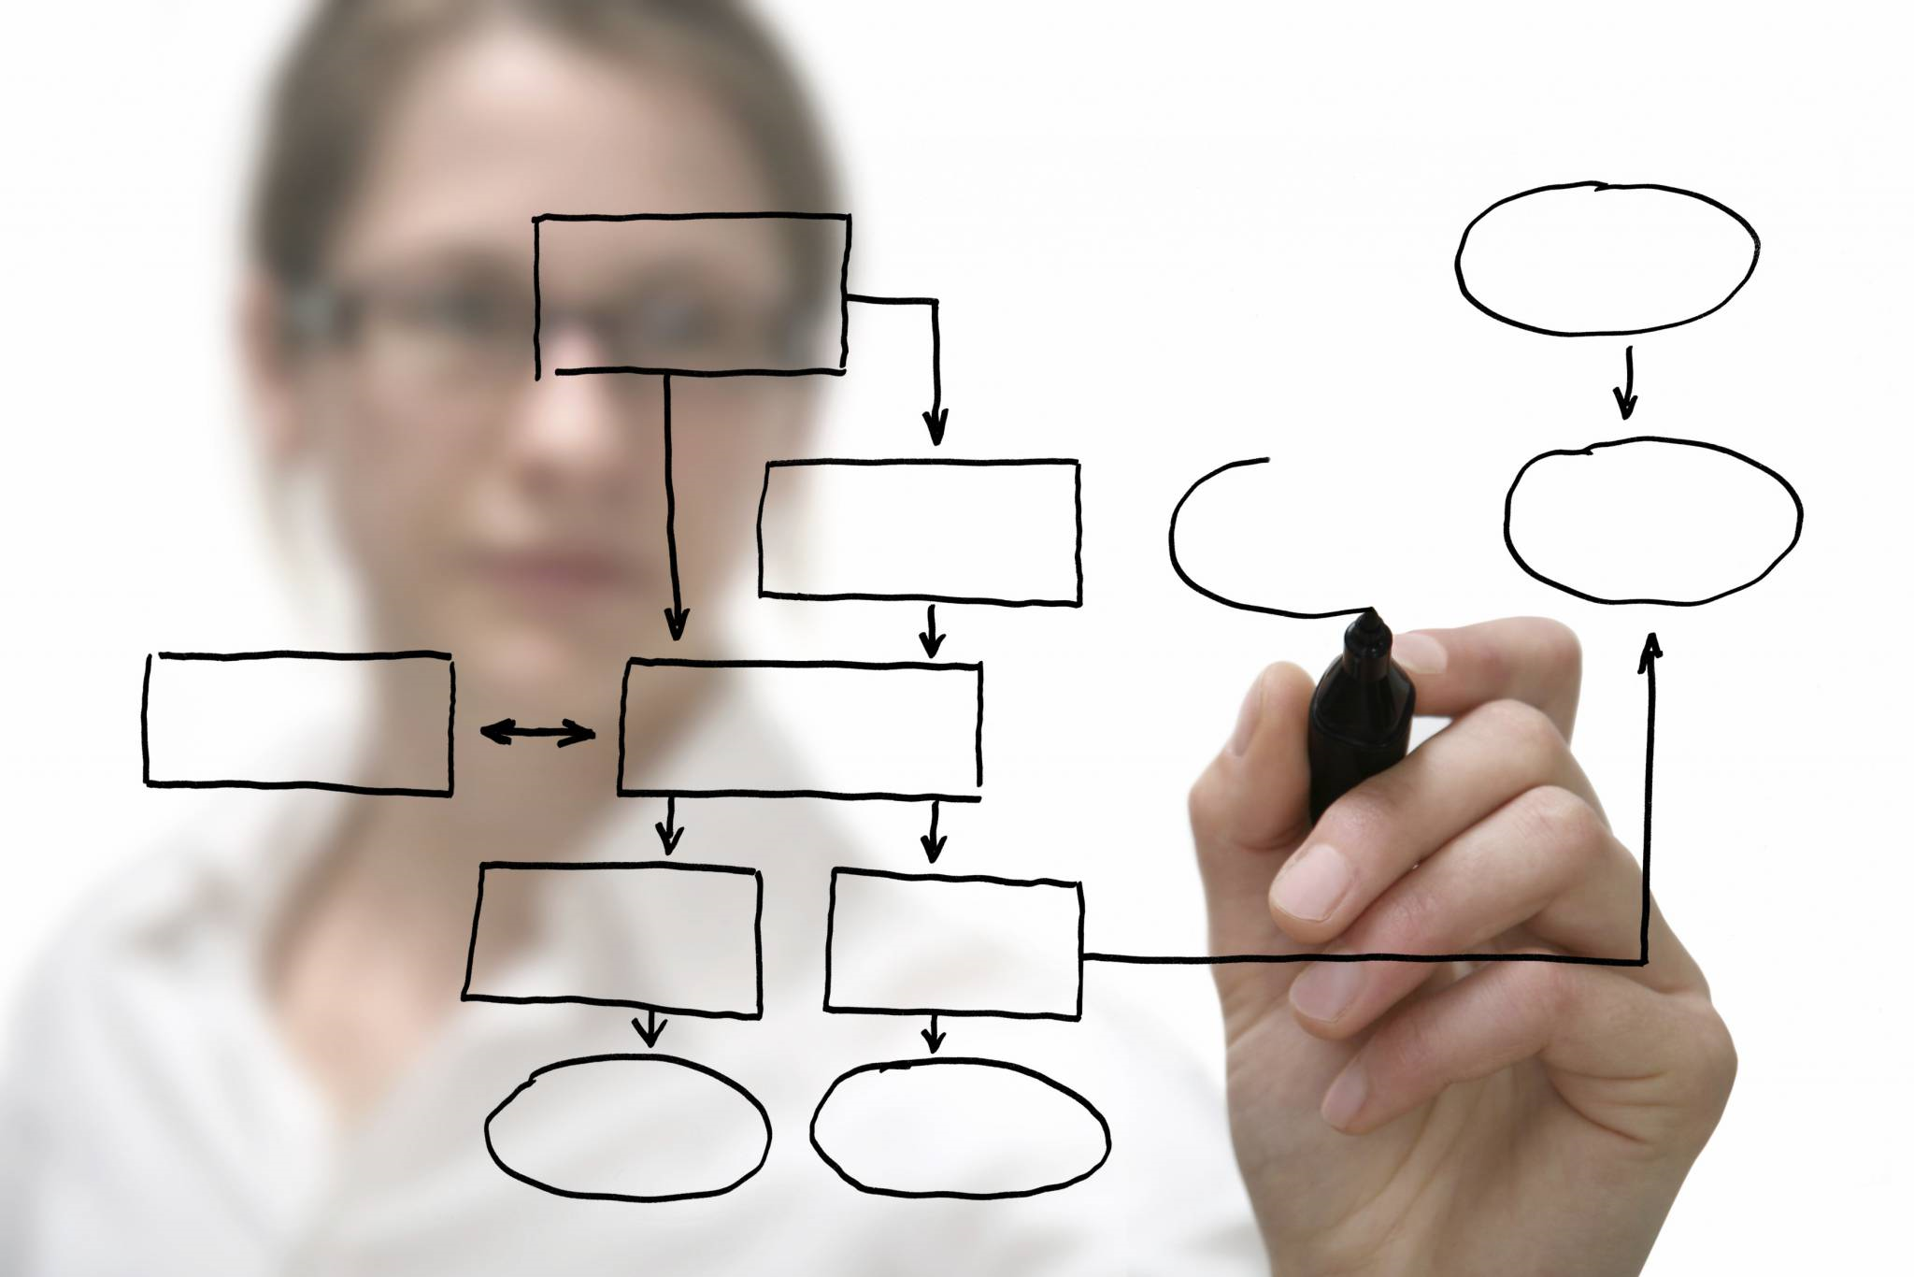
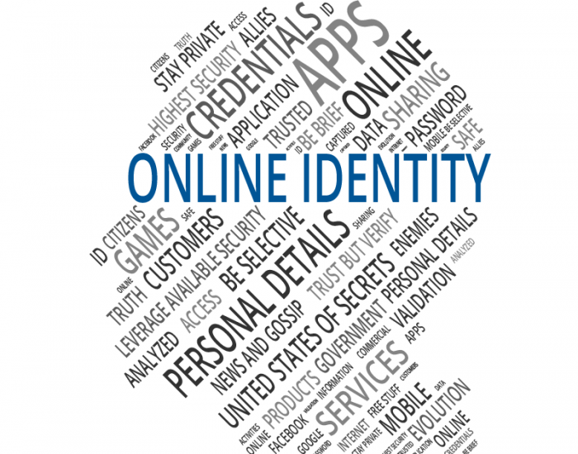
Trusted Digital Web
Trusted
Digital
Web
Fully Integrated Experience
DIGITAL IDENTITY
Decentralized Currency
(cryptocurrency)
Decentralized Workflows
(business processes)
Universal Digital Identity
(people, organizations, things,
& business documents)
Trusted Digital Web - Hyperonomy Digital Identity Lab - Parallelspace Corporation
2019-10-16

Slide 21
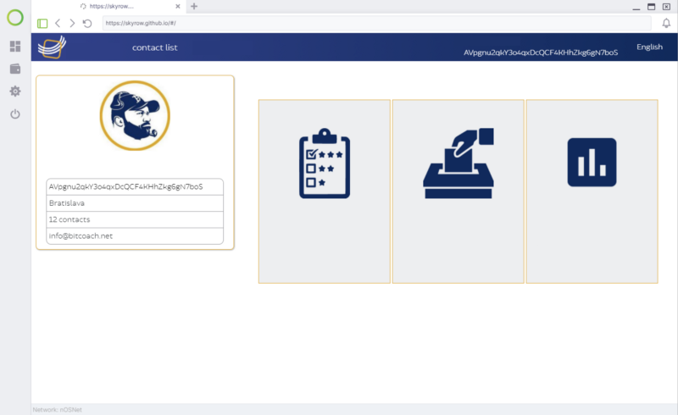
Trusted Digital Web Fully Integrated Experience
Decentralized Workflows
(business processes)
Trusted
Digital
Web
purchasing
business choreography
Fully
Integrated Experience
transfers and trading
Decentralized Currency
(cryptocurrency)
Universal Digital Identity (UDID) (people, organizations, things,
& business documents)
21

Slide 22
Decentralized Currency
Use of existing decentralized currencies (cryptocurrencies), gateways and exchanges
Leveraging the underlying blockchain platform used for digital identity and credential verification

Slide 23
Decentralized Workflows
Graphical modeling of workflow template based on accepted industry standards
“Swim lanes” diagrams
Business Process Model and Notation (BPMN) – Object Management Group
Standardized Visual Notation
Standardized Modeling Experience
Standardized Serialization Format (XML)
BPMN workflow templates (XML) are easily compiled into a small and efficient byte-code for execution on the blockchain or in a Trusted Digital Agent

Slide 24
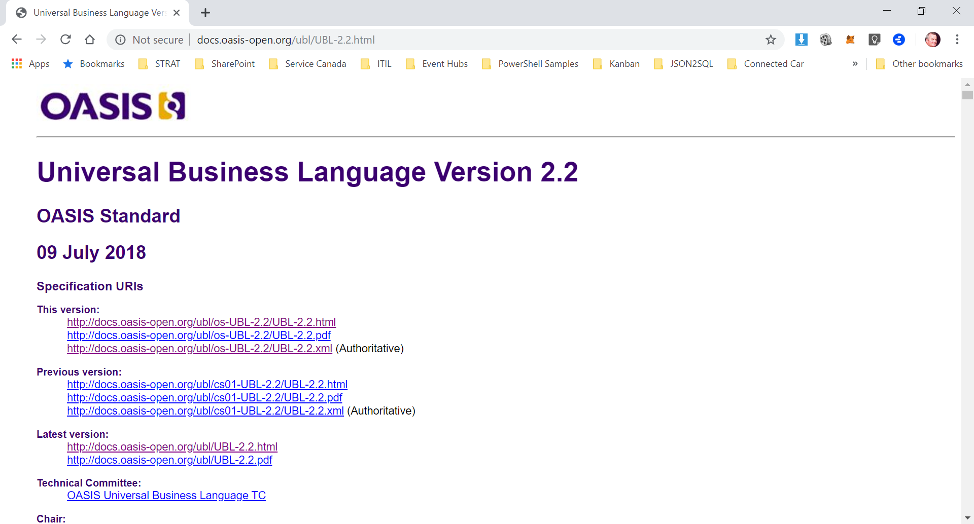
Universal Digital Identifiers and Digital Identities
Verifiable Digital Identifiers, Identities, and Credentials
A person, a place, a thing, an organization, digital visual or audio composition, business document, …
Non-verifiable Digital Identifiers, Identities, and Credentials
For everything else

Slide 25
Standard Schemas for Business Documents: Universal Business Language (UBL) 2.2

Slide 26
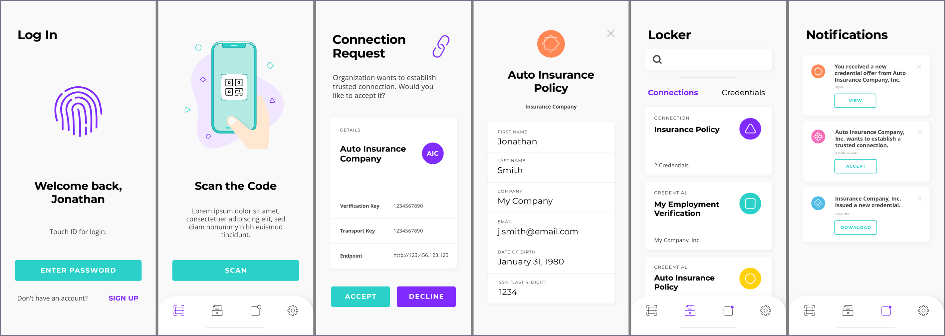
Trusted Digital Assistant (TDA)
Fully Integrated Experience
Mobile UX
Mobile AI
Mobile Agent
Mobile Wallet
Wallet Subledgers

Slide 27
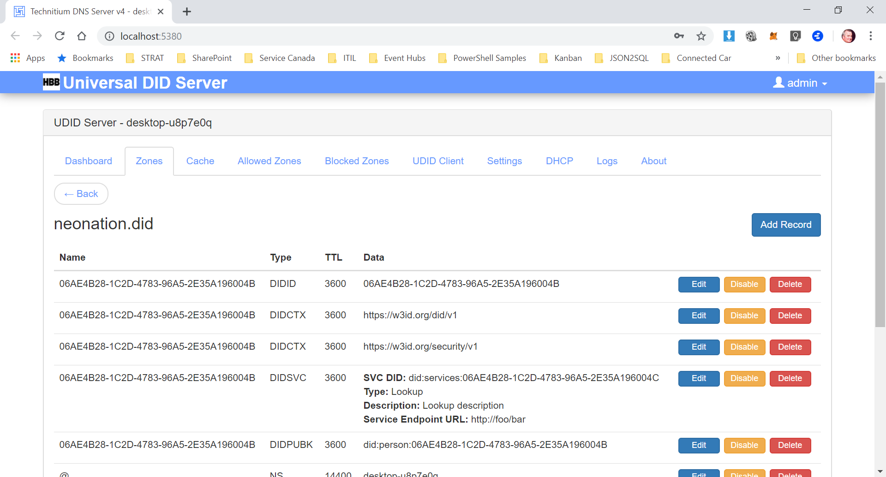
Universal DID Server (#UDIDServer)
Trusted
Digital
Web
Based on existing, common, every day protocols: DNS

Slide 28
 Final Notes
Trusted Digital Web - Hyperonomy Digital Identity Lab - Parallelspace Corporation
2019-10-16

Slide 29
NEON Never Ending innOvatioN
NATION
Independent Nation State
Consortium • Volume Buying Group • Integrated Supply Chain • Social Community • Value Added Network Corporation • Society
Trusted Digital Web
HYPERONOMY BUSINESS BLOCKCHAIN
Friction-less, trusted, standards-based, general-purpose platform for end-to-end business processing on a global scale

Slide 30
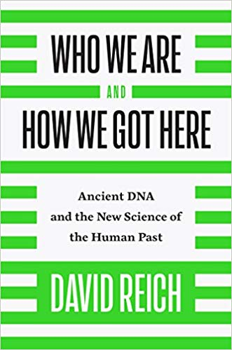
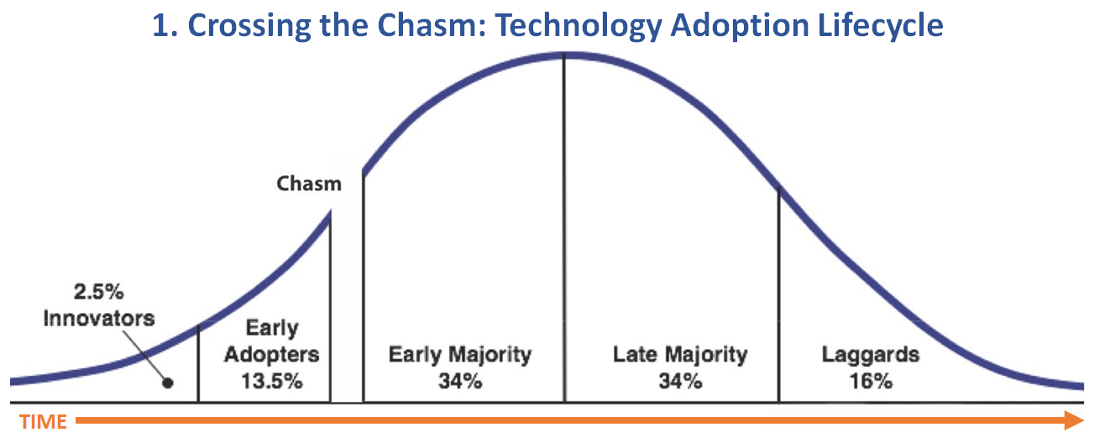
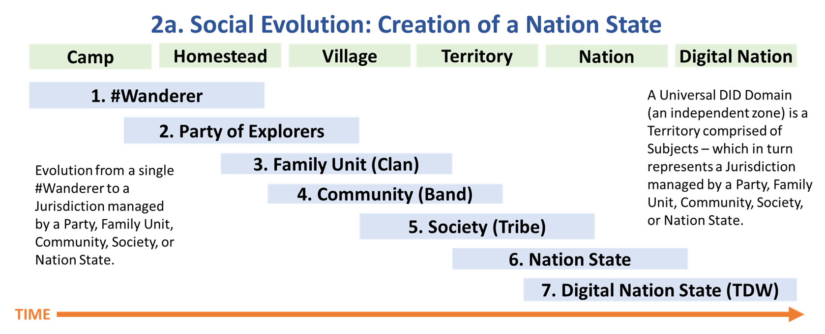
Social Evolution and the Creation of a Nation State

Slide 31
Note of Caution
We’re still in the very early market in relation to the use and application of blockchain technology …especially as it relates to digital identity
While there are a number of leading specifications, implementations, and governance frameworks in the market today, I don’t believe they are close to becoming “the industry standard”
They are too new, too unproven, and too risky. Need to consider other technologies that are pervasive on the Internet, in your data centers, and in the Cloud
“Change is inevitable”

Slide 32
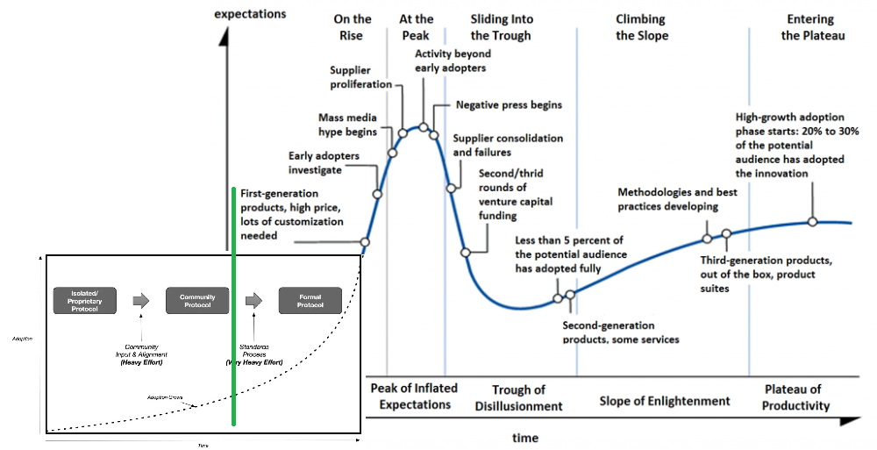
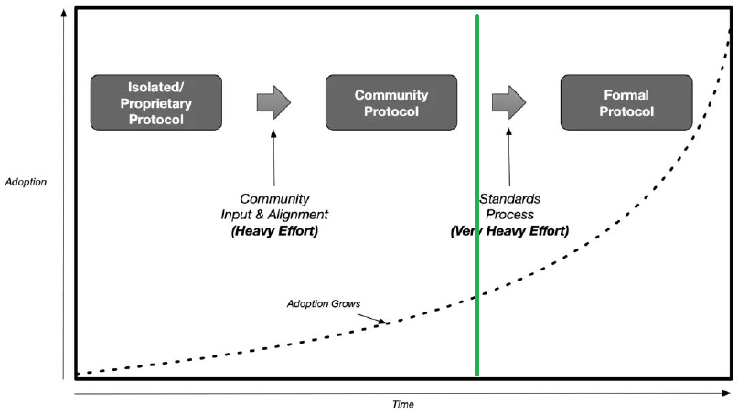
Final Note on Adoption

Slide 33
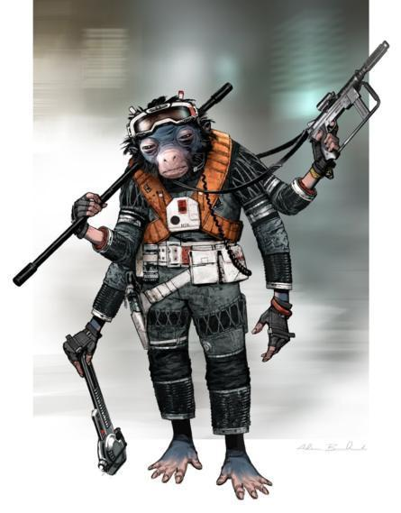
 QUESTIONS?
Michael Herman Hyperonomy Digital Identity Lab Parallelspace Corporation Alberta, CANADA
Email: mwherman@Parallelspace.net
Twitter: @mwherman2000
Trusted Digital Web - Hyperonomy Digital Identity Lab - Parallelspace Corporation
2019-10-16

Slide 34
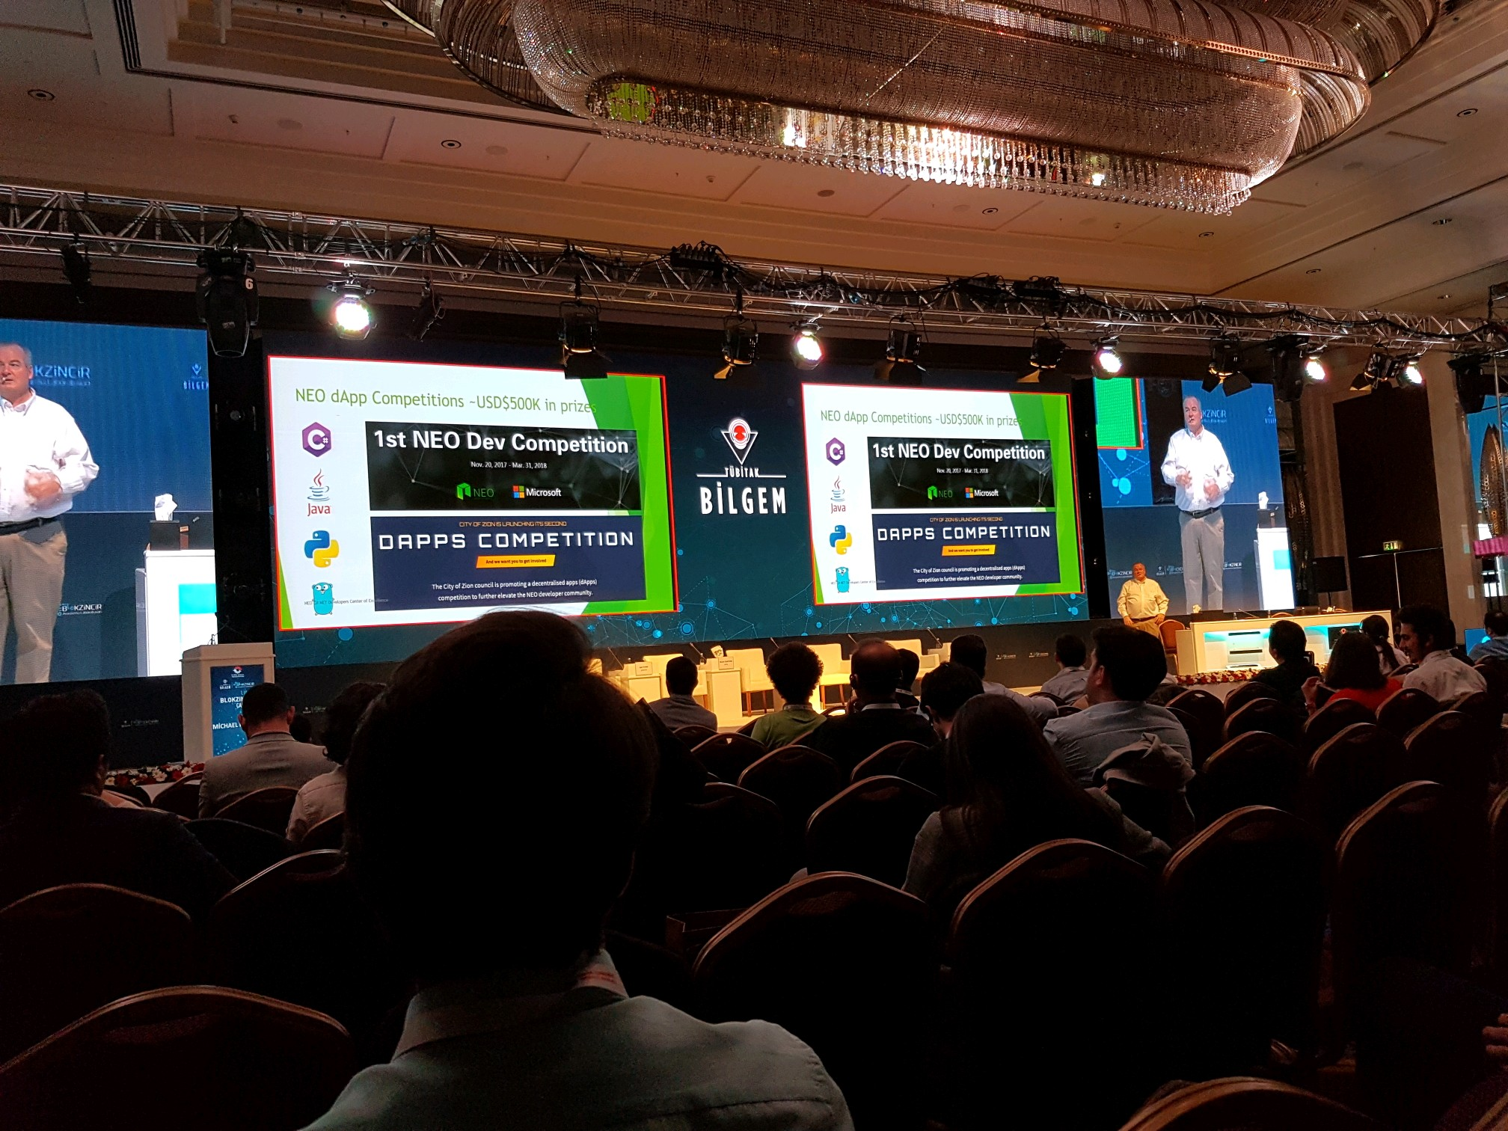

Slide 35
Although some days I feel like this…

